Slide 1

Student Training for Faking It

Slide 2

3 Parts of the Training
Why We Have Spiritual Conversations – John 4
Faking It Proxe & Script Walk-through
FAQs & Pro Tips
Notes:
For the Leader:
John 4. This is a brief walk through of John 4 to give an apologetic for going out on campus with a proxe. The point is that going to Samaria (or on campus) is as much for the disciples as it is for the woman and her village. You can do this as a brief 5 minute walk through, or spend time studying John 4. As a bonus, living water features in our gospel allegory. You can choose to focus in there as well.
Refresh Proxe and Script. Take time to allow students to answer the questions for themselves, this allows them to share more authentically with non-Christians.
Gospel Allegory. Students may have questions about where the allegory comes from, we have included a section with the text of the allegory and the Biblical inspiration. An allegory doesn’t express everything someone needs to know to follow Jesus. Instead, we hope to intrigue people to sign up to explore Jesus in your small groups where they can see Jesus and hear an invitation to faith.
FAQs

Slide 3
Why We Have Spiritual Conversations – John 4
Notes:
God is at work on our campus in ways we cannot see. Like Jesus says in John 4:35, we want to learn to open our eyes of faith to see our campus differently.

Slide 4
John 4
⁴ Now [Jesus] had to go through Samaria. ⁵ So he came to a town in Samaria called Sychar, near the plot of ground Jacob had given to his son Joseph. ⁶ Jacob’s well was there, and Jesus, tired as he was from the journey, sat down by the well. It was about noon.
⁷ When a Samaritan woman came to draw water, Jesus said to her, “Will you give me a drink?” ⁸ (His disciples had gone into the town to buy food.)
⁹ The Samaritan woman said to him, “You are a Jew and I am a Samaritan woman. How can you ask me for a drink?” (For Jews do not associate with Samaritans.)
¹⁰ Jesus answered her, “If you knew the gift of God and who it is that asks you for a drink, you would have asked him and he would have given you living water” …
Notes:
Read the scripture and discuss John 4. Help students take note of the ways Jesus crosses boundaries to connect with the woman.

Slide 5
John 4
²¹ “Woman,” Jesus replied, “believe me, a time is coming when you will worship the Father neither on this mountain nor in Jerusalem. ²² You Samaritans worship what you do not know; we worship what we do know, for salvation is from the Jews. ²³ Yet a time is coming and has now come when the true worshipers will worship the Father in the Spirit and in truth, for they are the kind of worshipers the Father seeks. ²⁴ God is spirit, and his worshipers must worship in the Spirit and in truth.”
²⁵ The woman said, “I know that Messiah” (called Christ) “is coming. When he comes, he will explain everything to us.”
²⁶ Then Jesus declared, “I, the one speaking to you — I am he.”...

Slide 6
John 4
³⁴ “My food,” said Jesus, “is to do the will of him who sent me and to finish his work. ³⁵ Don’t you have a saying, ‘It’s still four months until harvest’? I tell you, open your eyes and look at the fields! They are ripe for harvest. ³⁶ Even now the one who reaps draws a wage and harvests a crop for eternal life, so that the sower and the reaper may be glad together. ³⁷ Thus the saying ‘One sows and another reaps’ is true. ³⁸ I sent you to reap what you have not worked for. Others have done the hard work, and you have reaped the benefits of their labor.”
³⁹ Many of the Samaritans from that town believed in him because of the woman’s testimony, “He told me everything I ever did.” ⁴⁰ So when the Samaritans came to him, they urged him to stay with them, and he stayed two days. ⁴¹ And because of his words many more became believers. ⁴² They said to the woman, “We no longer believe just because of what you said; now we have heard for ourselves, and we know that this man really is the Savior of the world.”
Notes:
The trip to Samaria was not just for the thirsty samaritan woman and her thirsty village. It was also for the 12 disciples. They needed to learn to love across cultural and gender boundaries. They need to learn to lift up their eyes from their focus on logistics and “lunch duty” to see spiritual realities unfolding right in front of them.
In the same way, the Faking it Proxe is not just for the new students we are about to meet. It is for us as well. We need to learn to love everyone made in the image of God. And we need to learn to lift up our eyes and see more deeply how God is drawing each one to be filled with his living water.
You and I will be transformed in the process of inviting others into Jesus’ restoration!

Slide 7
John 4 Listening Prayer
Notes:
Lead Listening Prayer. In the Gospels, Jesus repeatedly asks, “What do you want me to do for you?” Open the prayer time with that prompt. Jesus wants to hear what we need today. Tell him what you need or where you are thirsty. Invite Jesus to bring his living water to that part of your life.

Slide 8
Faking It Proxe Script Walk Through

Slide 9
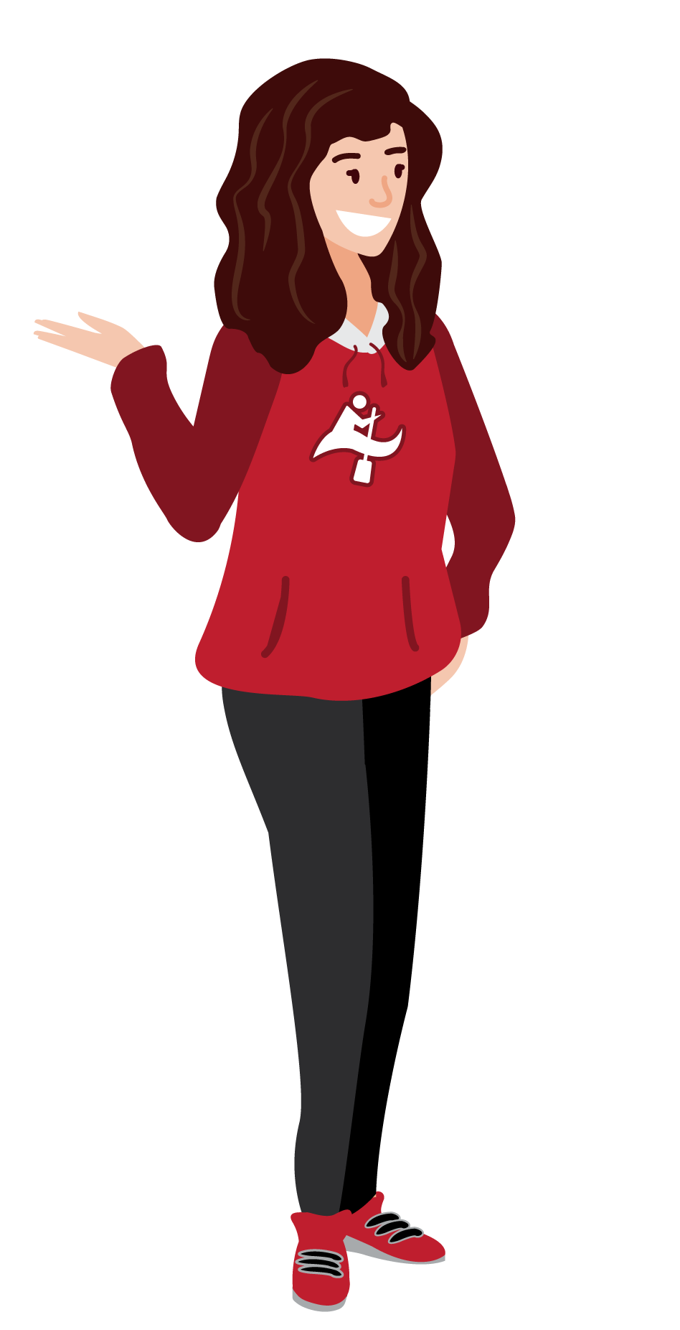
Hello!
Do you want to take our survey?
I’m ________ with InterVarsity Christian Fellowship. We’re talking about how college students tend to fake it.
Think about the people you know. Where are they more fake? Social media, or their mental health?
(Optional): How can you tell if someone is faking it?

Slide 10

Sometimes we try to project an image of how we want to be seen. How do you want others to perceive you? Why?”
(Read the words, give them a moment to think about them. Vote on yellow side, and share your answer.)
“I sometimes wish others would see me as _____ (pick yours and share why)”
(Move to the blue side.) “Sometimes we hide parts of ourselves. What do you tend to hide?” (allow them to vote) Failure, pain, anxiety, self-doubt?”
(Share yours candidly. Be curious. Ask why.)
Thanks for being honest.
In InterVarsity, we believe that Jesus invites us to be more real with our lives. Can I share a story with you where Jesus highlights the importance of being honest?

Slide 11

In this story, Jesus is saying that it is better to be a flawed seeker than a perfectionist religious leader. He just wants us to be honest with our questions, our emotions, and our mistakes.
Could you please read the story out loud?
What do you think about Jesus’ conclusion? (read the blue text on the lined part of the panel)
How real do you want to be with God?

Slide 12

This is our “Honest Quiz”, it’s an exercise to see how real you want to be with Jesus today.
Circles 1 & 2: (The purpose of these circles is to let people opt out early on if they want to. If they opt out at any time, offer them an invitation like this): “Ok. Thank you for being real with me. I have really enjoyed this conversation. We could use someone honest like you in our community. Interested?”
Circle 3: (Read the question. If they say yes): First, pick an area of brokenness we’ve experienced recently. Mine is ________.
Second, I’ll read this prayer out loud, and we’ll be open to Jesus together briefly. If you want, you could even say it out loud.
Do you want to give this a try?
(If yes: pray with them! The brief pause should only be about 10 seconds).
How did it feel to be open to God?
InterVarsity is a community that wants to grow in being more real with each other and with God. Sign up via this contact card to learn more about our community! We’d love to have you!
(If they seem interested in more): Can I share a summary about what it means to live your life being fully honest with Jesus?

Slide 13
Faking It Pocket Proxe Script Walk Through

Slide 14
I’m ________ with InterVarsity Christian Fellowship. We’re talking about how college students tend to fake it.
Sometimes we try to project an image of how we want to be seen. How do you want others to perceive you? Why?”
(Read the words, give them a moment to think about them. Vote on yellow side, and share your answer.)
“I sometimes wish others would see me as _____ (pick yours and share why)”
(Move to the blue side.) “Sometimes we hide parts of ourselves. What do you tend to hide?” (allow them to vote) Failure, pain, anxiety, self-doubt?”
(Share yours candidly. Be curious. Ask why.)
Thanks for being honest.
In InterVarsity, we believe that Jesus invites us to be more real with our lives. Can I share a story with you where Jesus highlights the importance of being honest?

Slide 15
In this story, Jesus is saying that it is better to be a flawed seeker than a perfectionist religious leader. He just wants us to be honest with our questions, our emotions, and our mistakes.
Could you please read the story out loud?
What do you think about Jesus’ conclusion? (read the blue text on the lined part of the panel)
How real do you want to be with God?
InterVarsity is a community that wants to grow in being more real with each other and with God. Sign up via this contact card to learn more about our community! We’d love to have you!

Slide 16
FAQs
How do you tell if they are ready for “more” - and you have an opportunity to share the gospel?
If they had a meaningful moment in prayer, or you sense that they have more questions left to ask, it is appropriate to invite them to hear the gospel. Use this resource to share: LINK
What is listening prayer, and how do I interpret the 10 second prayer pause if they ask?
Listening prayer is a way we interact with God where we don’t do all the talking. We pause with an open heart and allow God to meet us in a real way. God meets us in a variety of ways - sometimes it is just being present with us in our feelings. Other times, we may experience a word or image that speaks to us.
What does “exalted” mean in Panel 3?
Exalted means honored. Jesus is honoring people who are real about their brokenness instead of looking down of others for not being perfect.
What if someone goes off the rails on Christians being so fake?
Try: “I agree with you. You remind me of Jesus - he went into the center of the fake religious leaders and called out their hypocrisy. Thanks for being honest!”
What if someone says, ‘I like being fake. It’s better”?
You can reply with: “Thanks for being honest about your fakeness. How’s it going for you?”
Notes:
Add: international students

